Slide 1
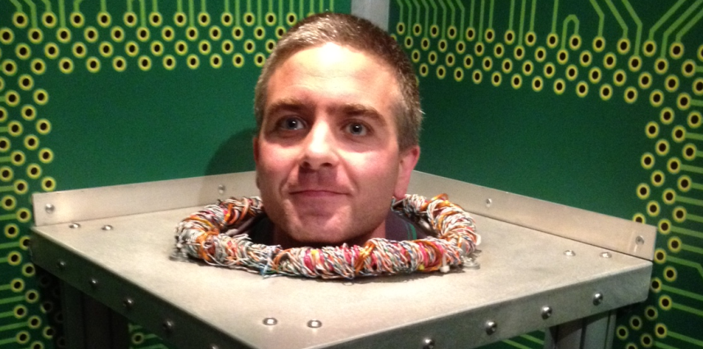
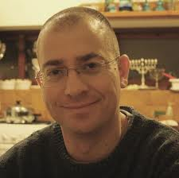
Tightfit: adaptive parallelization with foresight
Omer Tripp and Noam Rinetzky
TAU,IBM
TAU

Slide 2
data-dependent parallelism
parallelization opportunities depend not only on the program, but also on its input data
different inputs
different levels of parallelism

Slide 3
app.s with data-dependent para.
graph algorithms
Dijkstra SSSP
Boruvka MST
Kruskal MST
scientific applications
Barnes-Hut
discrete event simulation
…
ML / data mining
agglomerative clustering
survey propagation
computational geometry
Delaunay mesh refinement
Delaunay triangulation

Slide 4
problem statement
effective parallelization of applications with data-dependent parallelism
choose most appropriate initial parallelization mode per input data
switch between modes of the parallelization system upon phase change
adapt parallelization per input characteristics

Slide 5
running example: Boruvka MST
graph = /* read input */
worklist = graph.getNodes()
@Atomic
doall (node n₁ : worklist) {
worklist.remove(n₁)
(n₁,n₂) = lightestEdge(n₁)
n₃ = doEdgeContraction(n₁,n₂)
worklist.insert(n₃)
}

Slide 6
Boruvka MST: illustration
n₁
n₂
2
n₃
6
n₄
3
7
4
5
1
n₅
n₆
n₇

Slide 7
Boruvka MST: illustration
n₁
n₂
2
n₃
6
n₄
3
7
4
5
1
n₅
n₆
n₇

Slide 8
Boruvka MST: illustration
n₁
n₂
2
n₃
6
n₄
3
7
4
5
1
n₅
n₆
n₇

Slide 9
Boruvka MST: illustration
n₁
n₂
2
n₃
6
n₄
c₂
3
7
4
5
1
c₁
n₅
n₆
n₇

Slide 10
Boruvka MST: illustration
n₁
n₂
2
n₃
6
n₄
c₂
3
7
4
5
1
c₁
n₅
n₆
n₇

Slide 11
Boruvka MST: illustration
n₂
2
c₃
6
n₃
c₂
4
5
7
c₁
n₆

Slide 12
Boruvka MST: illustration
n₂
2
c₃
4
5
c₁
n₆

Slide 13
Boruvka MST: illustration
(early phase)
n₁
n₂
2
n₃
6
n₄
3
7
4
5
1
n₅
n₆
n₇
disjoint

Slide 14
Boruvka MST: illustration
(late phase)
n₂
2
c₃
4
5
c₁
n₆
overlap

Slide 15
Boruvka MST: analysis
different input graphs
=> different levels of parallelism
different phases
=> different levels of parallelism (decay)
data-dependent parallelism
adaptive parallelization

Slide 16
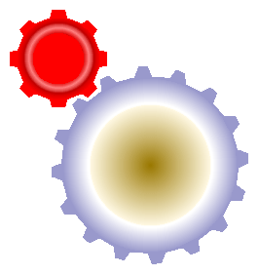
existing adaptive para. approaches
input
para. mode
e.g.:
# of threads
protocol
lock granularity
…
system state
e.g.:
abort/commit ratio
access patterns to sys. data structures
…
runtime
parallelization
system
hindsight:
reactive response to input data
reactive response to phase change

Slide 17
our approach
input
para. mode
e.g.:
# of threads
protocol
lock granularity
…
system state
e.g.:
abort/commit ratio
access patterns to sys. data structures
…
runtime
parallelization
system

Slide 18
our approach
input
para. mode
directly relate between input characteristics and available parallelism
foresight:
proactive handling of input data
proactive handling of phase change

Slide 19
the Tightfit system
input
para. mode
offline (per sys.)
user spec
available parallelism -> system mode
input -> features
offline (per app.)
feature sampling
features -> available parallelism

Slide 20
user spec: input features
features Graph:g {
“nnodes”: { g.nnodes(); }
“density”: { (2.0 * g.nedges()) /
g.nnodes() * (g.nnodes()-1); }
“avgdeg”: { (2.0 * g.nedges()) /
g.nnodes(); }
…
}

Slide 21
feature sampling
n₂
2
c₃
6
“nnodes”
n₃
5
c₂
“density”
4
5
7
0.5
worklist.remove(n₁)
(n₁,n₂) = lightestEdge(n₁)
n₃ = doEdgeContraction(n₁,n₂)
worklist.insert(n₃)
“avgdeg”
c₁
n₆
2
…
n₂
2
c₃
“nnodes”
n₃
3
“density”
4
0.66
worklist.remove(n₁)
(n₁,n₂) = lightestEdge(n₁)
n₃ = doEdgeContraction(n₁,n₂)
worklist.insert(n₃)
“avgdeg”
c₁
1.33

Slide 22
features -> available parallelism
challenge
how to measure available parallelism?

Slide 23
features -> available parallelism
worklist.remove(n₁)
(n₁,n₂) = lightestEdge(n₁)
worklist.remove(n₁)
worklist.remove(n₁)
(n₁,n₂) = lightestEdge(n₁)
n₃ = doEdgeContraction(n₁,n₂)
worklist.remove(n₁)
(n₁,n₂) = lightestEdge(n₁)
n₃ = doEdgeContraction(n₁,n₂)
worklist.insert(n₃)
2
6
n₂
c₃
n₃
c₂
g
7
4
5
…
c₁
n₆
worklist.remove(n₁)
(n₁,n₂) = lightestEdge(n₁)
worklist.remove(n₁)
(n₁,n₂) = lightestEdge(n₁)
n₃ = doEdgeContraction(n₁,n₂)
worklist.insert(n₃)
worklist.remove(n₁)
worklist.remove(n₁)
(n₁,n₂) = lightestEdge(n₁)
n₃ = doEdgeContraction(n₁,n₂)

Slide 24
features -> available parallelism
quantitative (density)
(normalized) # of dependencies between transactions
worklist.remove(x)
(x,y) = lightestEdge(x) // reads w
z = doEdgeContraction(x,y) // connects z to w
worklist.insert(z)
worklist.remove(x)
(x,y) = lightestEdge(x)
z = doEdgeContraction(x,y)
worklist.insert(z)
w
z
…
structural (cdep)
(normalized) # of cyclic dep.s between transactions
worklist.remove(z)
(z,w) = lightestEdge(z)
k = doEdgeContraction(z,w)
worklist.insert(k)

Slide 25
features -> available parallelism
quantitative (density)
(normalized) # of dependencies between transactions
worklist.remove(x)
(x,y) = lightestEdge(x) // reads w
z = doEdgeContraction(x,y) // connects z to w
worklist.insert(z)
w
z
…
structural (cdep)
(normalized) # of cyclic dep.s between transactions
worklist.remove(z)
(z,w) = lightestEdge(z)
k = doEdgeContraction(z,w)
worklist.insert(k)

Slide 26
features -> available parallelism
z
worklist.remove(x)
(x,y) = lightestEdge(x) // reads w
z = doEdgeContraction(x,y) // connects z to w
worklist.insert(z)
worklist.remove(z)
(z,w) = lightestEdge(z)
k = doEdgeContraction(z,w)
worklist.insert(k)
w

Slide 27
features -> available parallelism
quantitative (density)
(normalized) # of dependencies between transactions
worklist.remove(x)
(x,y) = lightestEdge(x) // reads w
z = doEdgeContraction(x,y) // connects z to w
worklist.insert(z)
worklist.remove(x)
(x,y) = lightestEdge(x)
z = doEdgeContraction(x,y)
worklist.insert(z)
w
z
…
structural (cdep)
(normalized) # of cyclic dep.s between transactions
worklist.remove(z)
(z,w) = lightestEdge(z)
k = doEdgeContraction(z,w)
worklist.insert(k)

Slide 28
features -> available parallelism
challenge
how to measure available parallelism?
challenge
how to correlate with input features?

Slide 29
features -> available parallelism
input | features | profile
n₃
“nnodes”=4.00
“density”=0.66
density = 0.XXX
cdep = 0.YYY
“avgdeg”=2.00
n₃
“nnodes”=3.00
density = 0.ZZZ
cdep = 0.WWW
“density”=0.66
“avgdeg”=1.33
…
(“nnodes”, “density”, “avgdeg”) (density,cdep)

Slide 30
features -> available parallelism
challenge
how to measure available parallelism?
challenge
how to correlate with input features?
challenge
how to decide system mode?

Slide 31
available parallelism -> sys. mode
(progressive) para. modes m₁<…<m_{k} of the sys.
×
synthetic benchmark with parameterized para.
(density,cdep) { m₁ , … , m_{k} }

Slide 32
features -> available parallelism
challenge
how to measure available parallelism?
challenge
how to correlate with input features?
challenge
how to decide system mode?

Slide 33
the Tightfit system
input
para. mode
offline (per sys.)
user spec
available parallelism -> system mode
input -> features
offline (per app.)
feature sampling
features -> available parallelism

Slide 34
experiments
1st experiment
adaptation by switching bet. STM protocols
comparison: Tightfit vs (i) underlying protocols, (ii) direct offline learning, and (iii) online learning (abort/commit)
2nd experiment
adaptation by tuning concurrency level
comparison: Tightfit vs (i) fixed levels, and (ii) direct offline learning

Slide 35
experiments
1st experiment
adaptation by switching bet. STM protocols
comparison: Tightfit vs (i) underlying protocols, (ii) direct offline learning, and (iii) online learning (abort/commit)
2nd experiment
nonadaptive variants
adaptation by tuning concurrency level
comparison: Tightfit vs (i) fixed levels, and (ii) direct offline learning

Slide 36
experiments
1st experiment
adaptation by switching bet. STM protocols
comparison: Tightfit vs (i) underlying protocols, (ii) direct offline learning, and (iii) online learning (abort/commit)
traditional approach: tracks abort/commit ratio
2nd experiment
adaptation by tuning concurrency level
comparison: Tightfit vs (i) fixed levels, and (ii) direct offline learning

Slide 37
experiments
1st experiment
adaptation by switching bet. STM protocols
comparison: Tightfit vs (i) underlying protocols, (ii) direct offline learning, and (iii) online learning (abort/commit)
same as Tightfit, but learns features -> mode directly based on wall-clock exec. time
same as Tightfit, but learns features -> mode directly based on wall-clock exec. time
2nd experiment
adaptation by tuning concurrency level
comparison: Tightfit vs (i) fixed levels, and (ii) direct offline learning

Slide 38
benchmarks
benchmark | description
Boruvka | MST algorithm
Genome | performs gene sequencing
Intruder | detects network intrusions
KMeans | implements K-means clustering
MatrixMultiply | performs matrix multiplication
Vacation | emulates travel reservation system
Bank | emulates banking system
Elevator | simulates a system of elevators

Slide 39
results: STM protocols
 | speedup all w/o MMul |  | retries all w/o MMul
retry | 3.75 | 3.04 | 1.53 | 1.84
DATM-FG | 4.38 | 3.77 | 0.32 | 0.38
DATM-CG | 3.96 | 3.28 | -- | --
Tightfit | 4.91 | 4.43 | 0.21 | 0.25
online | 4.18 | 3.54 | 0.52 | 0.62
offline-4 | 4.92 | 4.44 | 0.22 | 0.26
offline-8 | 5.27 | 4.83 | 0.19 | 0.22

Slide 40
results: STM protocols
 | speedup all w/o MMul |  | retries all w/o MMul
retry | 3.75 | 3.04 | 1.53 | 1.84
DATM-FG | 4.38 | 3.77 | 0.32 | 0.38
DATM-CG | 3.96 | 3.28 | -- | --
Tightfit | 4.91 | 4.43 | 0.21 | 0.25
online | 4.18 | 3.54 | 0.52 | 0.62
offline-4 | 4.92 | 4.44 | 0.22 | 0.26
offline-8 | 5.27 | 4.83 | 0.19 | 0.22

Slide 41
results: STM protocols
 | speedup all w/o MMul |  | retries all w/o MMul
retry | 3.75 | 3.04 | 1.53 | 1.84
DATM-FG | 4.38 | 3.77 | 0.32 | 0.38
DATM-CG | 3.96 | 3.28 | -- | --
Tightfit | 4.91 | 4.43 | 0.21 | 0.25
online | 4.18 | 3.54 | 0.52 | 0.62
offline-4 | 4.92 | 4.44 | 0.22 | 0.26
offline-8 | 5.27 | 4.83 | 0.19 | 0.22

Slide 42
results: concurrency levels
 | retries Genome Boruvka Vacation |  |  | memory Bank Elevator
1 thread | 0 | 0 | 0 | 1 | 1
2 threads | 0.18 | 0.07 | 0.19 | 0.98 | 0.99
4 threads | 0.22 | 0.2 | 0.48 | 0.95 | 0.96
8 threads | 0.56 | 0.46 | 0.99 | 0.92 | 0.94
Tightfit | 0.47 | 0.31 | 0.76 | 0.93 | 0.94
offline-4 | 0.53 | 0.36 | 0.70 | 0.94 | 0.95
offline-8 | 0.51 | 0.33 | 0.72 | 0.96 | 0.96

Slide 43
results: concurrency levels
 | retries Genome Boruvka Vacation |  |  | memory Bank Elevator
1 thread | 0 | 0 | 0 | 1 | 1
2 threads | 0.18 | 0.07 | 0.19 | 0.98 | 0.99
4 threads | 0.22 | 0.2 | 0.48 | 0.95 | 0.96
8 threads | 0.56 | 0.46 | 0.99 | 0.92 | 0.94
Tightfit | 0.47 | 0.31 | 0.76 | 0.93 | 0.94
offline-4 | 0.53 | 0.36 | 0.70 | 0.94 | 0.95
offline-8 | 0.51 | 0.33 | 0.72 | 0.96 | 0.96

Slide 44
conclusion & future work
this work
foresight-guided adaptation
user contributes useful input features
offline analysis / quantitative + structural
future work
automatic detection of useful input features
auto-tuning capabilities

